Slide 1
FM 3rd Party grid components research.
- R & D TPX

Slide 2
1
Requirements
2
Candidates
3
Local Demo
4
Easy to learn

Slide 3
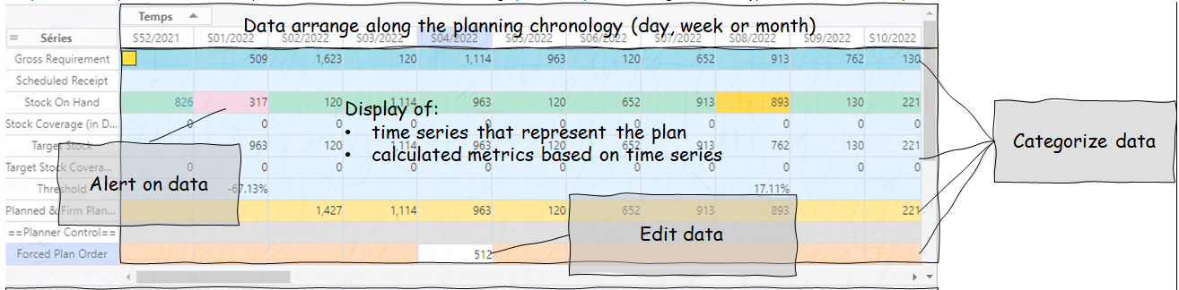
Basic Requirement:
Alert on data: set cell background colour
Font colour
Edit data: Copy/paste
Data format: % format, thousand/decimal separator

Slide 4
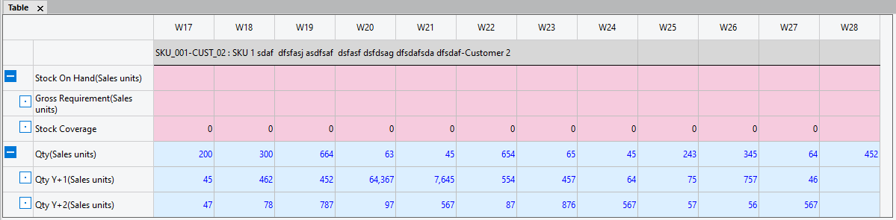
Nice to have Requirement:
Collapse/Expand group lines
Categorize data
In depth mode
Export to csv, excel(WYSIWYG)

Slide 5
Performance Requirement:
Capacity requirement
First step there is no performance requirement
Up to 40 lines of data in a grid
Next step: this grid will replace MLA to analyse data
Display 10,000 nodes with 10 time series, it is 100,000 rows on the grid

Slide 6
Technical Requirement:
Popular: easy to use, easy to find a solution if any questions
Documentation: good documentation, typical samples with explanation
Activity: reliable, quick fix if any issues, less risk of abandonment of maintenance
Commercial/OSS licenses: no commercial risk in use
Support: efficient reasonable response

Slide 7
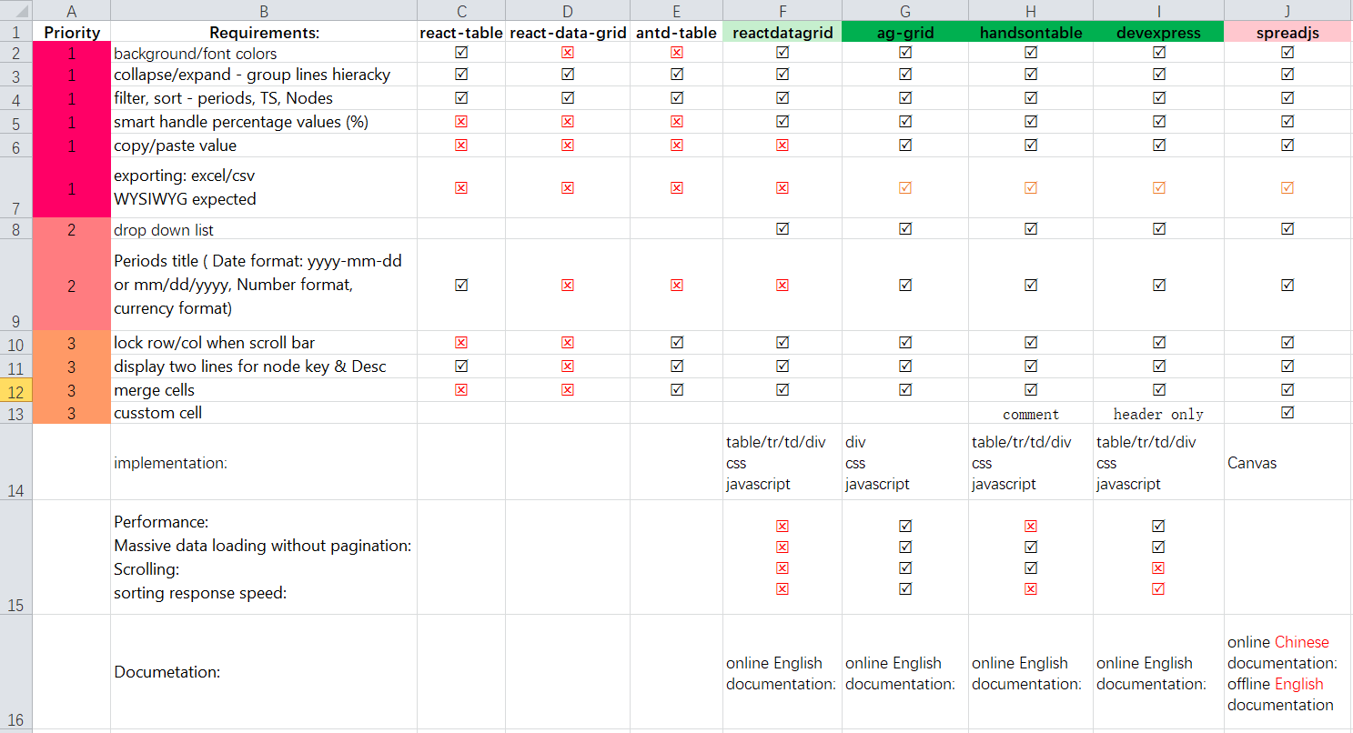
Grid components comparison
Notes:
Exporting: both can export .xml by default, but will loss the hierarchy information, background colour etc, will need customization coding to achieve WYSIWYG
SpreadJS: don’t have online English documentation at the time we start the research. Doulbe check with antd-table

Slide 8
Candidates
Ag-grid
Handsontable
DevExpress

Slide 9
Local Demo
Massive data (100,000 rows of data)
Implementation (coding perspective)
Loading time
Scrolling without pagination (virtual scrolling)
Hierarchy group
% trick with clipboard
Export to Excel

Slide 10
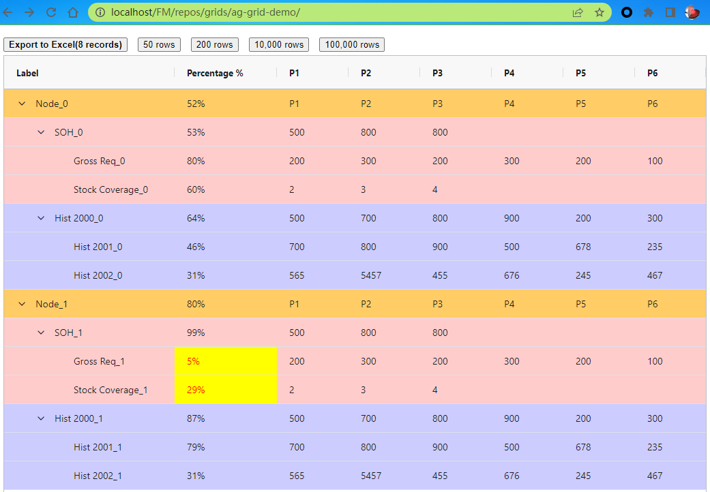
Ag-grid (https://www.ag-grid.com/documentation/)
100,000 data without pagination (100%)
Hierarchy (100%)
Filter, sorting (80% --missing sort on sub row)
Percentage trick with clipboard(100%)
Exporting, it can export but need extra work to get WYSIWYG (100%)
Implemented with Div + css + Javascript
Background colour (100%)
Export excel with hierarchy info, background colour, font colour with highlight(100%)
Num Of Data | 50 rows | 200 rows | 10,000 rows | 100,000 rows
Data Gen Cost (in ms) | 0 | 0 | 14 | 39
Total time Cost (in ms) | 18 | 34 | 231 | 1090

Slide 11
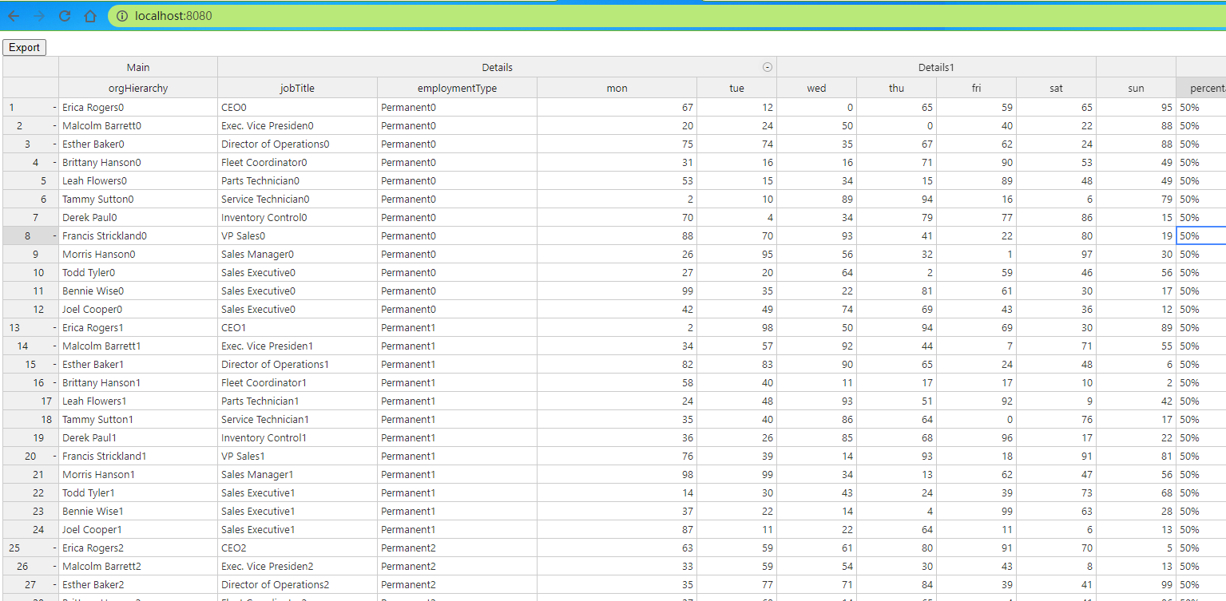
Handsontable (Local Demo)
100,000 data without pagination (100%)
Hierarchy (100%)
Filter, sorting (sorting will break group structure) (20%)
Percentage trick with clipboard ( 50% --missing copy paste)
Exporting, it can export csv not excel (20% - missing hierarchy info background colour font Colour & highlight)
Implemented with Div/tr/td/table Css Javascript
Notes:
Sorting okay on numeric data, poorly on sorting string, and it lost the hierarchy detail.

Slide 12
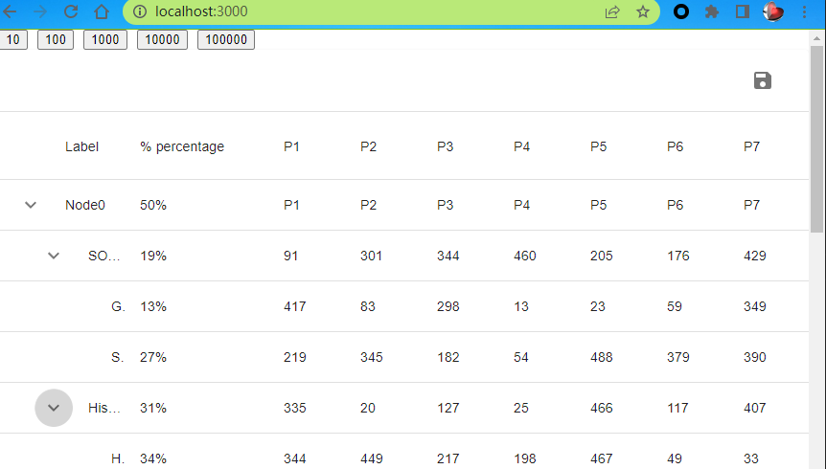
DevExpress (https://devexpress.github.io/devextreme-reactive/react/grid)
100,000 data without pagination (10% -- freezed on 100,000)
Hierarchy (100%)
Filter, sorting (80%-- --missing sort on sub row)
Percentage trick with clipboard ( 10% --missing copy paste)
Exporting, it can export csv not excel (20% - missing hierarchy info)
Implemented with Div/table/tr/td css Javascript
Num Of Data | 50 rows | 200 rows | 10,000 rows | 100,000 rows
Data Gen Cost (in ms) | 0 | 0 | 12 | 46
Total time Cost (in ms) | 15 | 12 | 1317 | 83403

Slide 13
support
1. easy to learn to get on with
2. reasonable online samples and documentations
3. support
response frequency
with email and ticket.

Slide 14

Result
Base on the demo performance, and user experience, we agreed on
Ag-grid
to be the outstanding one in this component comparison

Slide 15
Thanks for watching

